Slide 1

Beyond Pixels: The Art of Satellite Data Visualisation
By Astro Hackers
James Carron, Daniel Alvarez Carreno, Thomas Fischer, Iva Sekulic

Slide 2

Why SARt Challenge?
Bridging the gap between the digital and the physical
Illuminate significance of SAR sensors and their artistic potential

Slide 3
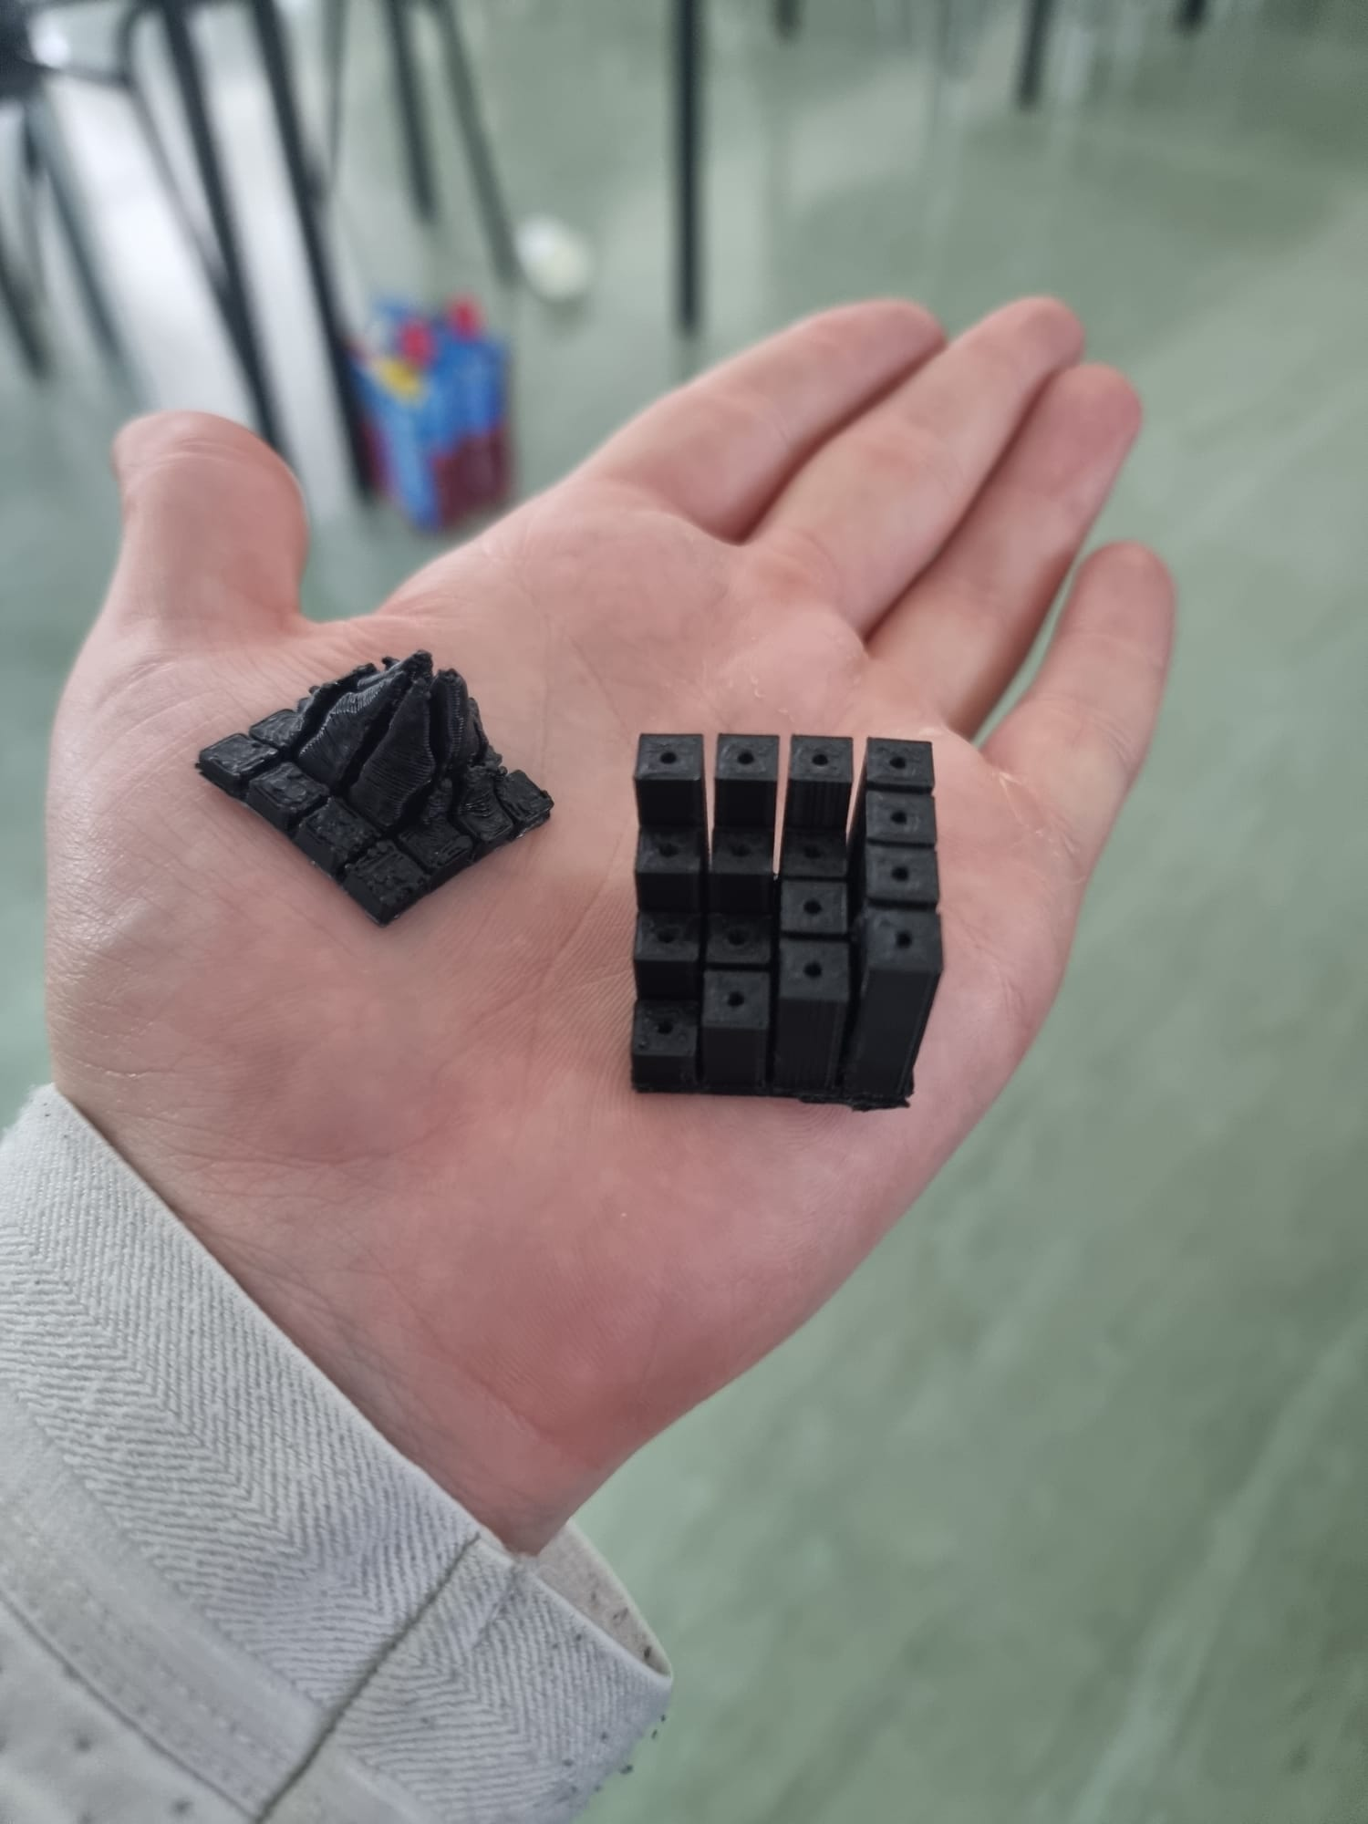
Bringing life to SAR data
Tactile
Making geographical differences
tangible

Slide 4

Data Used
Hofsjokull Glacier, Iceland
Generated the visual satellite data through colour topography
Used the HGT and the Metadata files to decode data
Art Piece was manufactured using 3D printers and designed using SolidWorks and Python for modelling
Art Piece demonstrates deformation well

Slide 5

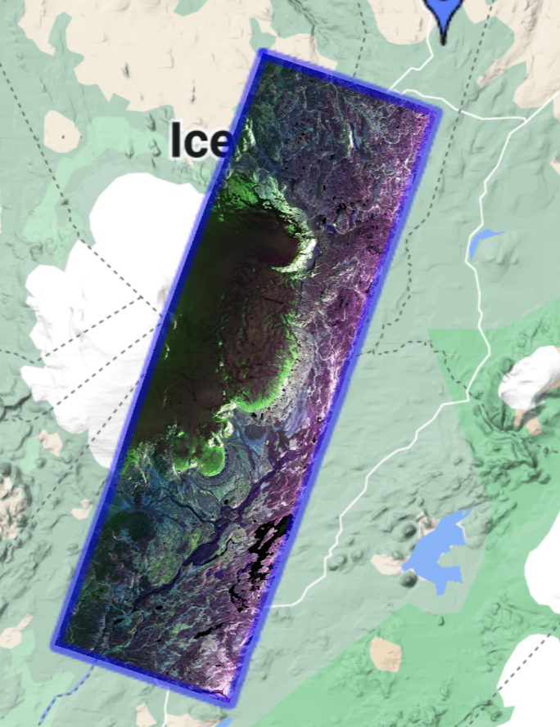
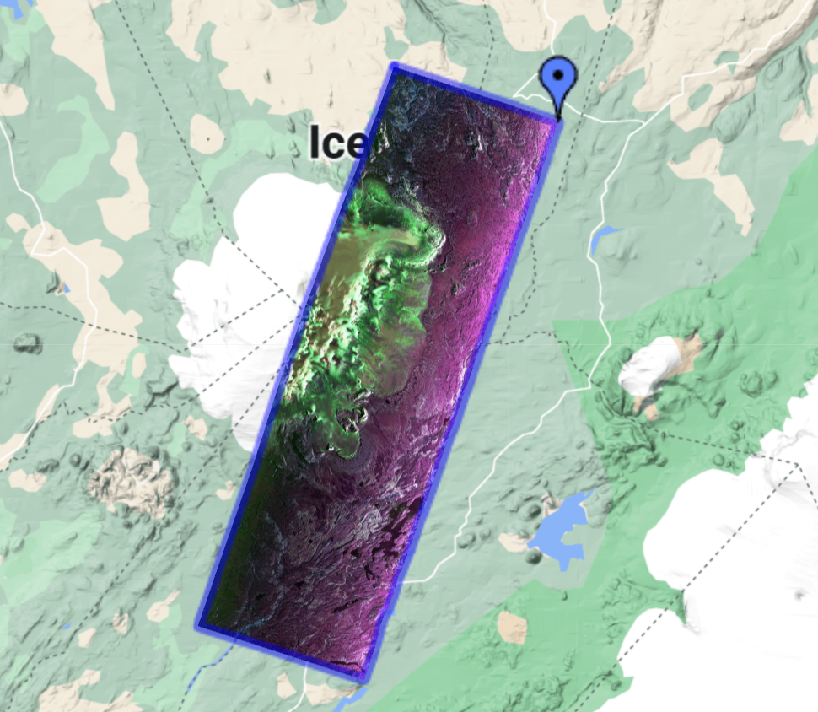
SAR Satellite Visual
June 14, 2012
May 29, 2015

Slide 6

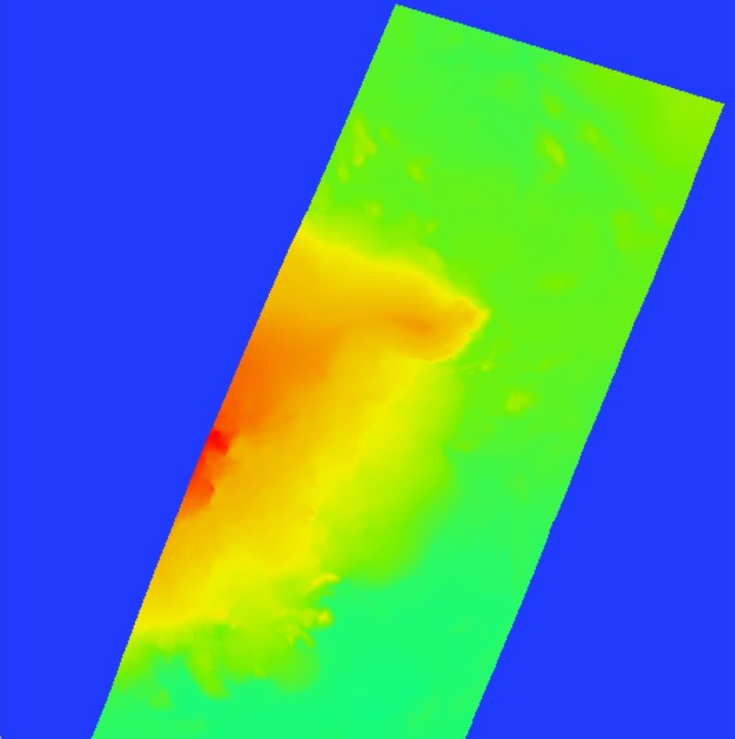
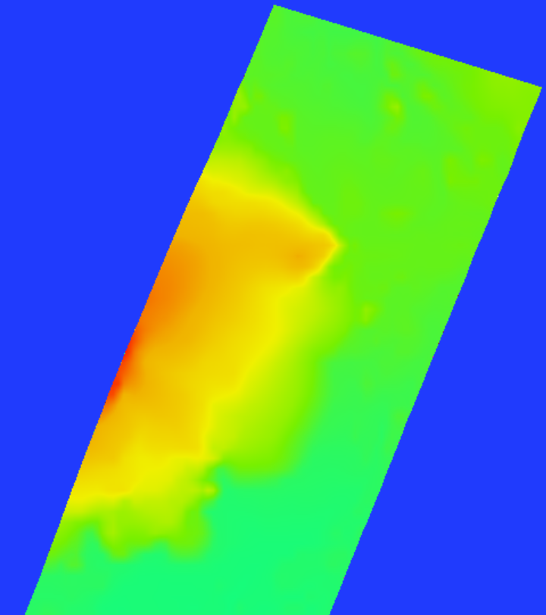
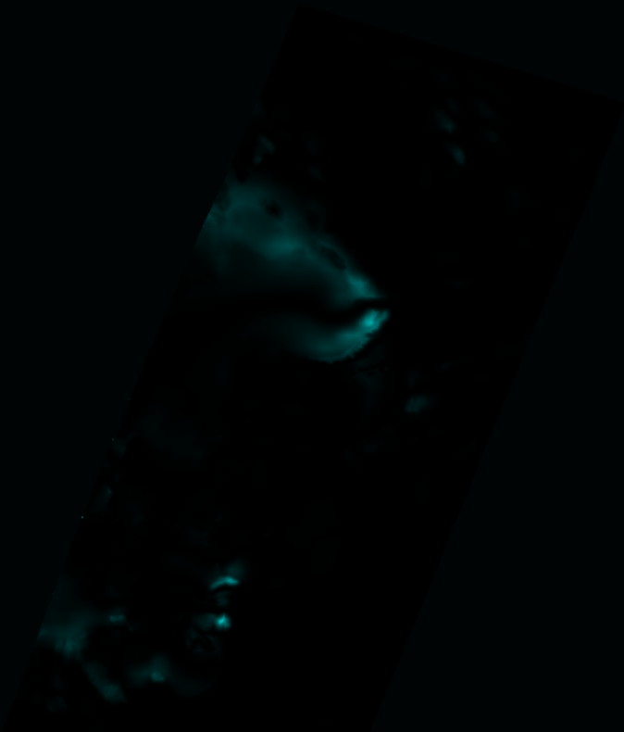
Colour Topography
June 14, 2012
May 29, 2015
Difference

Slide 7
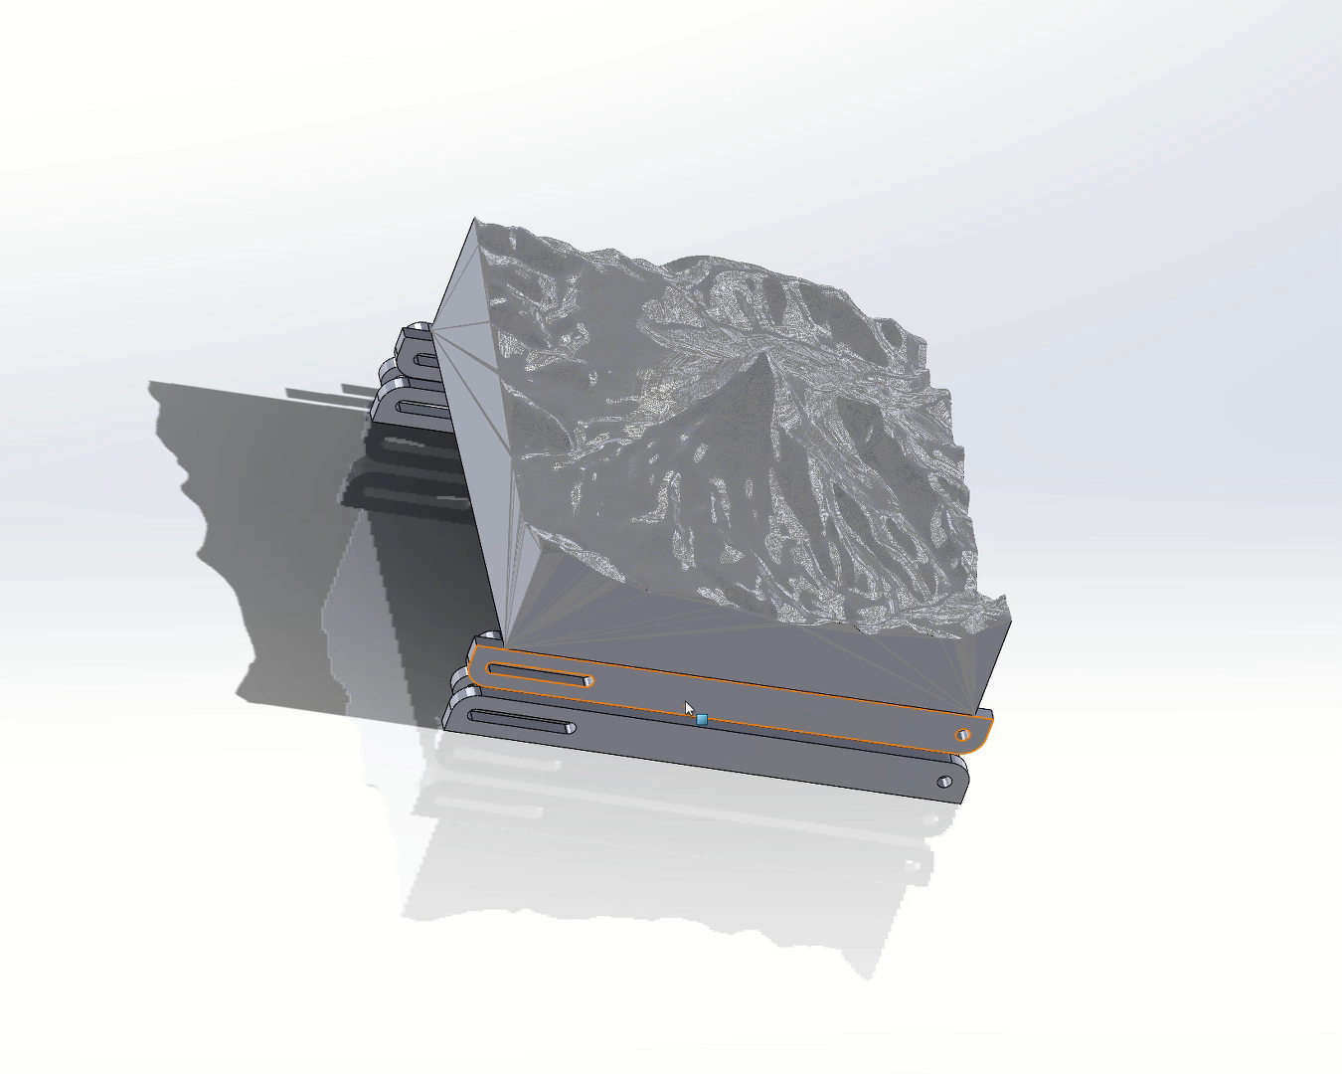

3D Topography
Made a scissor jack using a four - bar linkage
Allows for actuation of the model
3D model using a sample volcano

Slide 8
THE END

